Slide 1



PRODUCT RECOMMENDATION ENGINE
Amazon Product Dataset
Supervisor Name with Designation
PRESENTED BY:
Dr. Suresh kumar S,Professor
Karthick S 231801079
Karthikeyan B 231801080
Mehant Ayya Reddy 231801101

Slide 2
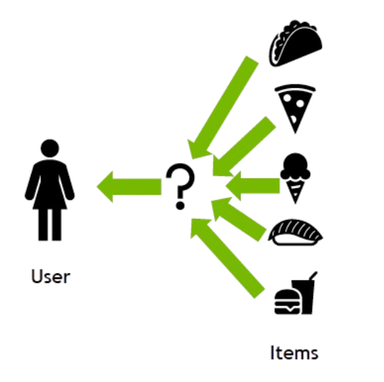
Introduction
The exponential growth of e-commerce platforms has created massive product catalogs.
Customers face difficulty finding relevant items due to information overload.
Recommendation systems help personalize product discovery and improve user satisfaction.
This project focuses on developing a content-based recommendation system that suggests products by analyzing textual similarity in product descriptions using TF-IDF and Locality Sensitive Hashing (LSH).

Slide 3
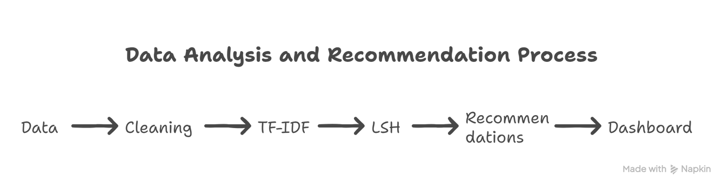
Abstract
This project presents a content-based product recommendation system built within the Databricks ecosystem using Amazon product data.
The workflow follows a Bronze → Silver → Gold architecture to ensure clean, reliable data processing.
Product features are extracted using TF-IDF (Term Frequency–Inverse Document Frequency) to represent text meaning.
Locality Sensitive Hashing (LSH) is applied to efficiently find similar products from large-scale datasets.
A web-based dashboard visualizes product insights, recommendations, and category-level analysis.
The system demonstrates scalable performance and accurate recommendations suitable for e-commerce platforms.

Slide 4

Literature Survey (Existing Systems)
Collaborative Filtering:
Recommends products based on user behavior and ratings. Works well when sufficient user data is available but fails with new users or new products (cold start problem).
Content-Based Filtering:
Focuses on product attributes like descriptions, titles, or specifications. Recommends similar items by analyzing textual similarity.
Hybrid Systems:
Combine both approaches for improved accuracy but require more complex infrastructure.
Our work:
In this project, the content-based approach is selected because it:
Works independently of user history.
Is effective for new or rarely purchased products.
Is easily scalable with text-based Amazon data.

Slide 5
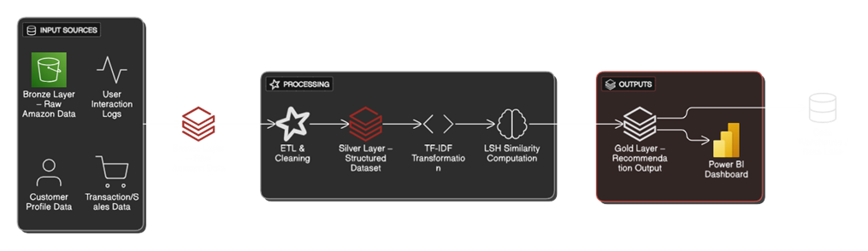
System Architecture
The system follows a multi-layer Databricks architecture ensuring scalability, modularity, and clean data flow.
Bronze Layer: Stores raw Amazon product and category data as imported from the source (JSON/CSV).
Silver Layer: Performs data cleaning, preprocessing, and text normalization to create a structured dataset.
Gold Layer: Contains refined, feature-engineered data ready for model building, similarity search, and visualization.
The model leverages TF-IDF for feature extraction and LSH for similarity computation.
Insights and recommendations are visualized through web dashboards connected to the Gold table.

Slide 6
Modules Overview
The system is divided into five main modules, each handling a specific stage of the workflow:
Data Extraction (Bronze Layer):
Collect raw Amazon product and category data for initial ingestion.
Data Cleaning & Preprocessing (Silver Layer):
Handle missing values, duplicates, and inconsistencies; normalize and prepare clean structured data.
Feature Engineering (TF-IDF):
Convert product descriptions into numerical vectors capturing text importance and meaning.
Similarity Computation (LSH):
Identify products with similar feature vectors using efficient hashing-based nearest neighbor search.
Visualization & Web Application:
Display insights, analytics, and recommendations via an interactive web dashboard.

Slide 7
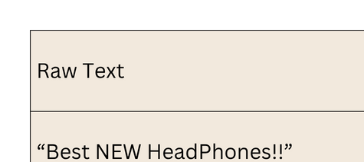
Data Cleaning and Preparation
The raw Amazon product and category data from the Bronze Layer often contains:
Missing values, duplicates, and inconsistent text formats.
Mixed or irrelevant product attributes.
The Silver Layer applies cleaning and transformation to prepare the dataset for analysis.
Cleaning Steps Include:
Removing duplicates and null records.
Standardizing text (lowercasing, removing punctuation, stop words).
Normalizing product descriptions for accurate vectorization.
The result is a structured, reliable Silver Table ready for feature extraction and modeling.
Example:

Slide 8
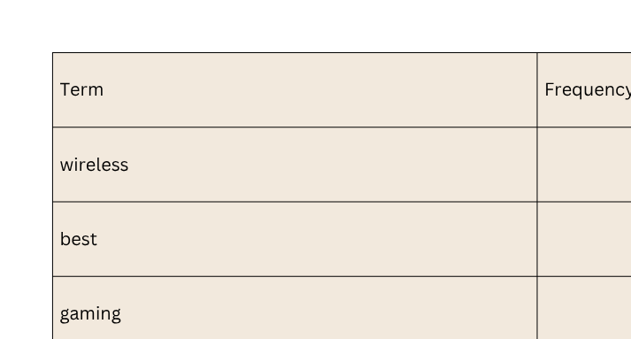
Feature Engineering (TF-IDF)
TF-IDF (Term Frequency–Inverse Document Frequency) transforms product descriptions into numerical vectors that represent word importance.
Words frequently used in a single product but rare across others get higher weights, capturing unique product characteristics.
This helps the model focus on distinctive terms like “wireless,” “moisturizing,” or “gaming,” instead of generic ones like “best” or “new.”
The output is a high-dimensional feature matrix used for similarity matching in the next phase.
Example:

Slide 9
Similarity Computation (Locality Sensitive Hashing - LSH)
After TF-IDF vectorization, product features are compared using Locality Sensitive Hashing (LSH).
LSH maps high-dimensional TF-IDF vectors into hash buckets, where similar products fall into the same bucket with high probability.
This drastically reduces computation time when searching for similar items in large datasets.
The BucketedRandomProjectionLSH algorithm from Spark MLlib is used for efficient similarity joins.
Output: for every product, a list of top-N similar products based on text similarity.

Slide 10
Web Application & Dashboard Visualization
The final output is presented through an interactive web-based dashboard, connected directly to the Silver/Gold tables in Databricks.
It allows dynamic visualization of product data, category insights, and recommendation outputs.
Three key dashboard pages include:
Product Analysis: Shows Top Reviewed, Highest Priced, and Category Volume — helps identify popular and high-value items.
Customer Engagement Insights: Displays review patterns, rating trends, and product sentiment distribution.
Recommendation Results: Shows similar products generated through TF-IDF + LSH similarity scores.

Slide 11
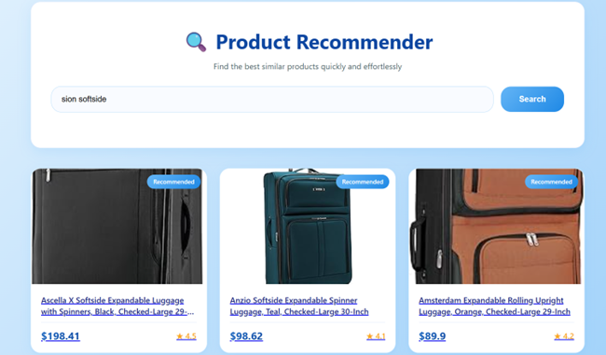
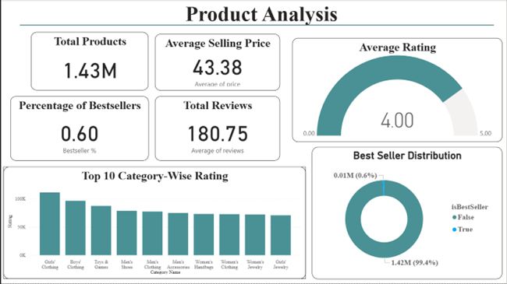
Analysis
Product Analysis (KPIs & Category Ratings)
Web Application – Recommended Product Interface

Slide 12
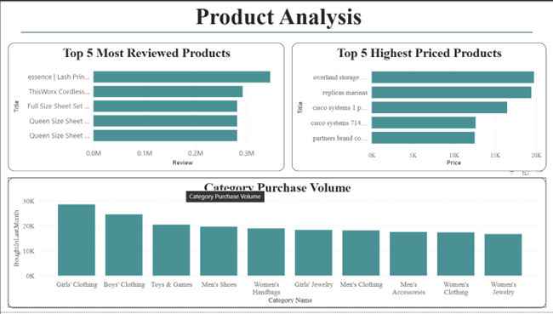
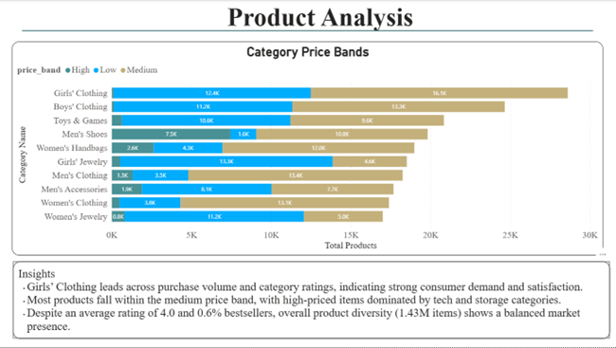
Analysis
Product Analysis (Category Price Bands)
Product Analysis (Top Reviewed, Highest Priced & Category Volume)

Slide 13
Results
The system successfully generated accurate and relevant product recommendations using text similarity.
TF-IDF + LSH achieved a balance between accuracy and computation speed, even for large Amazon datasets.
Databricks’ distributed processing improved scalability and reduced execution time significantly.
The final model delivers quick and meaningful recommendations directly through the dashboard interface.

Slide 14
Conclusion
The project successfully implemented a content-based recommendation system within the Databricks platform, leveraging the full data lifecycle from Bronze → Silver → Gold.
It demonstrated how TF-IDF can effectively capture textual meaning and LSH can accelerate similarity search across large datasets.
The interactive dashboard provided clear business insights and product-level recommendations.
Overall, the system proves that scalable, data-driven product recommendation pipelines can be built efficiently using Spark and Databricks.

Slide 15
Future Enhancements
Integrate Collaborative Filtering with the existing content-based model to create a hybrid recommender system for improved personalization.
Incorporate deep learning–based text embeddings (e.g., BERT or Word2Vec) for richer product understanding and contextual similarity.
Enable real-time streaming updates using Spark Structured Streaming for live product recommendations.
Extend the system with user feedback loops to continuously refine recommendation accuracy.
Deploy the complete solution as a cloud-hosted API or mobile app interface for broader accessibility.

Slide 16
Thank you

